Slide 1
OpenChain Monthly North America / Europe Meeting
2024-07-03

Slide 2
Anti-Trust Policy Notice
Linux Foundation meetings involve participation by industry competitors, and it is the intention of the Linux Foundation to conduct all of its activities in accordance with applicable antitrust and competition laws. It is therefore extremely important that attendees adhere to meeting agendas, and be aware of, and not participate in, any activities that are prohibited under applicable US state, federal or foreign antitrust and competition laws.
Examples of types of actions that are prohibited at Linux Foundation meetings and in connection with Linux Foundation activities are described in the Linux Foundation Antitrust Policy available at http://www.linuxfoundation.org/antitrust-policy. If you have questions about these matters, please contact your company counsel, or if you are a member of the Linux Foundation, feel free to contact Andrew Updegrove of the firm of Gesmer Updegrove LLP, which provides legal counsel to the Linux Foundation.

Slide 3
Regular Agenda
News
Work on standards and core material
Work on reference and supporting material
Any other business
Close of meeting

Slide 4
News

Slide 5
Meetings Across Asia
During the last two weeks:
Korea
Japan
China
A quick summary

Slide 6
Work on standards and core material

Slide 7
The ISO Standards – All The Open Issues
See Next Slide For Status And Next Steps
Security: https://github.com/OpenChain-Project/Security-Assurance-Specification/issues
Licensing: https://github.com/OpenChain-Project/License-Compliance-Specification/issues

Slide 8
Last OpenChain North America / Asia Call
Full Recording:
https://openchainproject.org/news/2024/06/24/openchain-monthly-north-america-and-asia-call-2024-06-18-full-recording
The following issues were closed during this call:
Security Assurance Review
Scope Suggestions from Expert RU/OP on OpenChain Security Assurance Specification 1.0 (WG3 N2348) 2022-09-17 #5 https://github.com/OpenChain-Project/Security-Assurance-Specification/issues/5
Comments on OpenChain security specification 1.1 – Maturity model consideration #11 https://github.com/OpenChain-Project/Security-Assurance-Specification/issues/11
[Improvement] SMK10 – Suggested addition of documented review process #13 https://github.com/OpenChain-Project/Security-Assurance-Specification/issues/13
License Compliance Review
Review notes: Version 3.0 OpenChain ISO/IEC 5230:2024 (proposed) – DRAFT #70 https://github.com/OpenChain-Project/License-Compliance-Specification/issues/70
We closed all open issues and formally moved into a Public Comment period for both draft specifications as potential updates to ISO/IEC 5230:2020 and ISO/IEC 18974:2023. Learn more: https://openchainproject.org/featured/2024/06/19/public-comment-period-2024

Slide 9
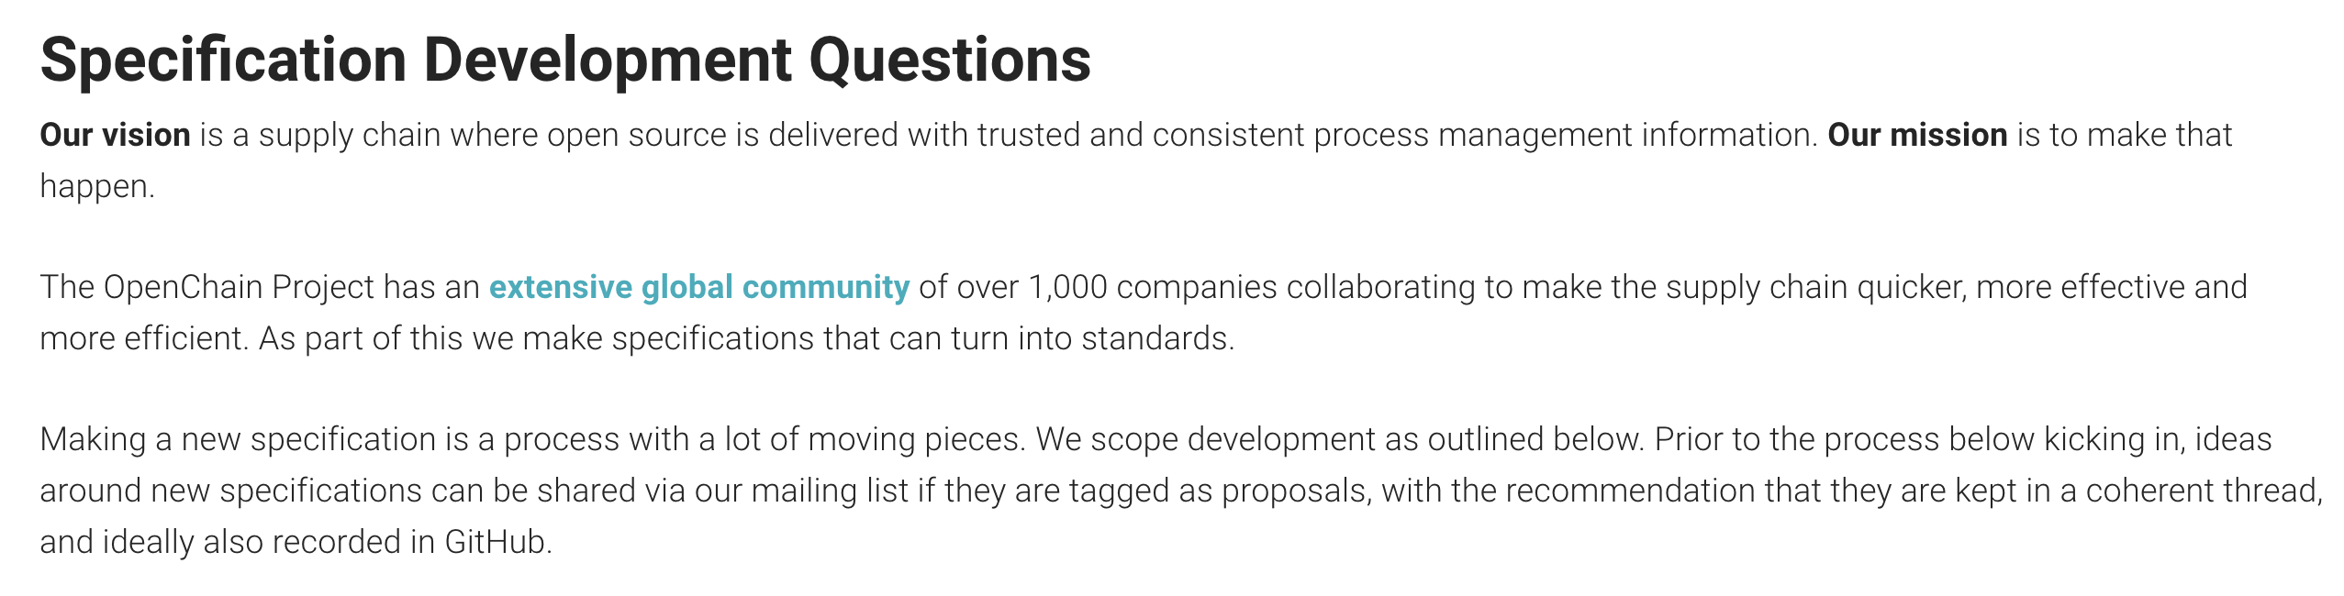
Specification Development Process #1
As per our FAQ: https://openchainproject.org/resources/faq#specification-development-questions

Slide 10
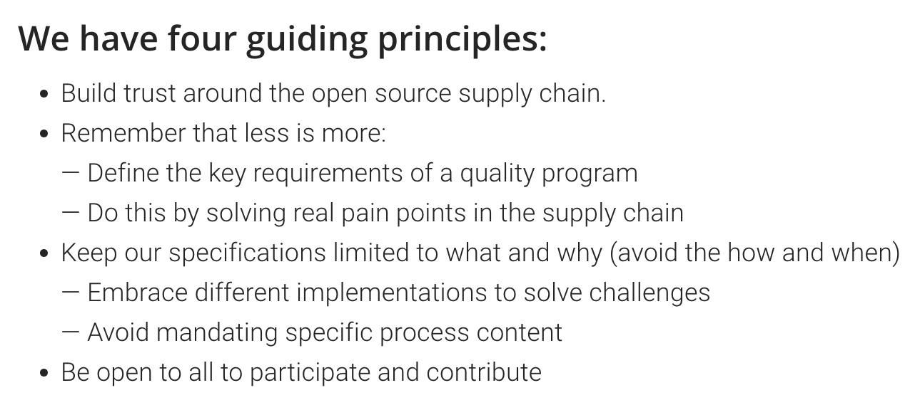
Specification Development Process #2

Slide 11
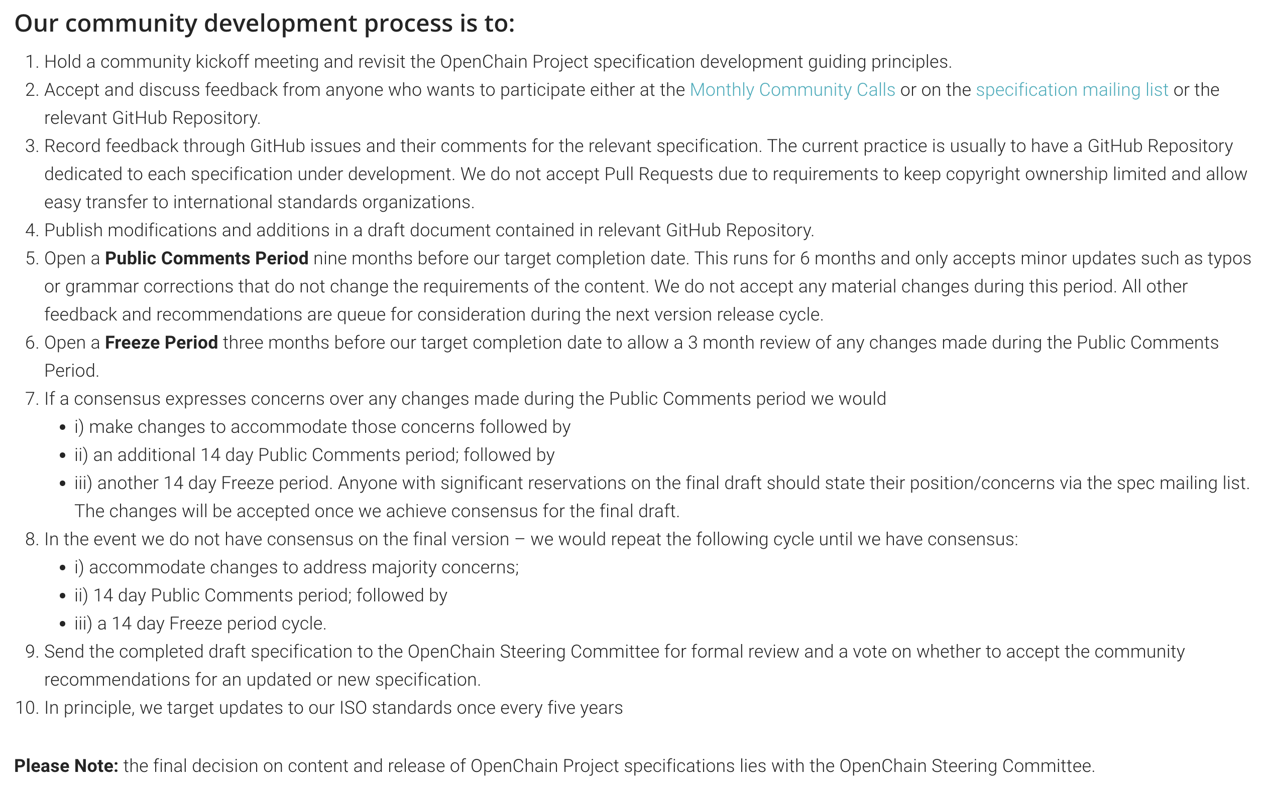
Specification Development Process #3

Slide 12

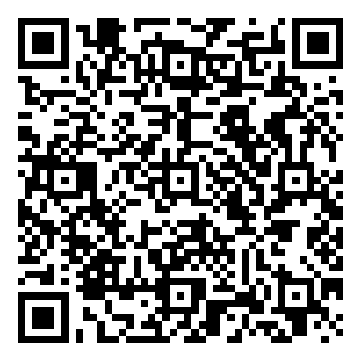
Starting 2024-06-19 ~ Ending 2024-012-19
The OpenChain Project has announced the beginning of its six month Public Comment Period for proposed draft updates to the open source license compliance (ISO/IEC 5230:2020) and open source security assurance (ISO/IEC 18974:2023) specifications.
As per our specification development process outlined in the project FAQ, this Public Comment Period will run for six months, and it will be followed by a three month Freeze Period.

Slide 13
Review of suggested changes to ISO/IEC 5230:2020
Current ISO standard:
https://github.com/OpenChain-Project/License-Compliance-Specification/blob/master/ISO-5230-2020/en/ISO-5230-2020.md
Current Next Generation Draft (pre-public comments period):
https://github.com/OpenChain-Project/License-Compliance-Specification/blob/master/3.0/en/openchain-license-compliance-3.0.md
All open issues have been closed by the Specification Work Group
https://github.com/OpenChain-Project/License-Compliance-Specification/issues?q=is%3Aissue+is%3Aclosed
Next:
Six month public comment period launched 19tth June 2024 as per our specification development process:
https://openchainproject.org/resources/faq#specification-development-questions
This will be followed by a Three Month freeze period

Slide 14
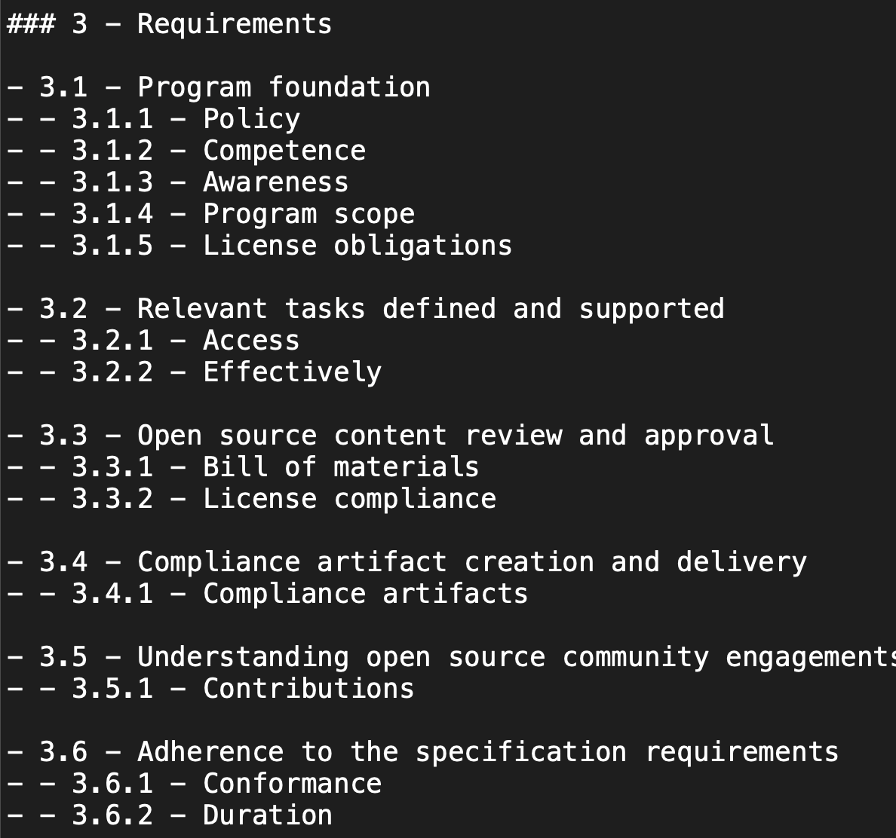
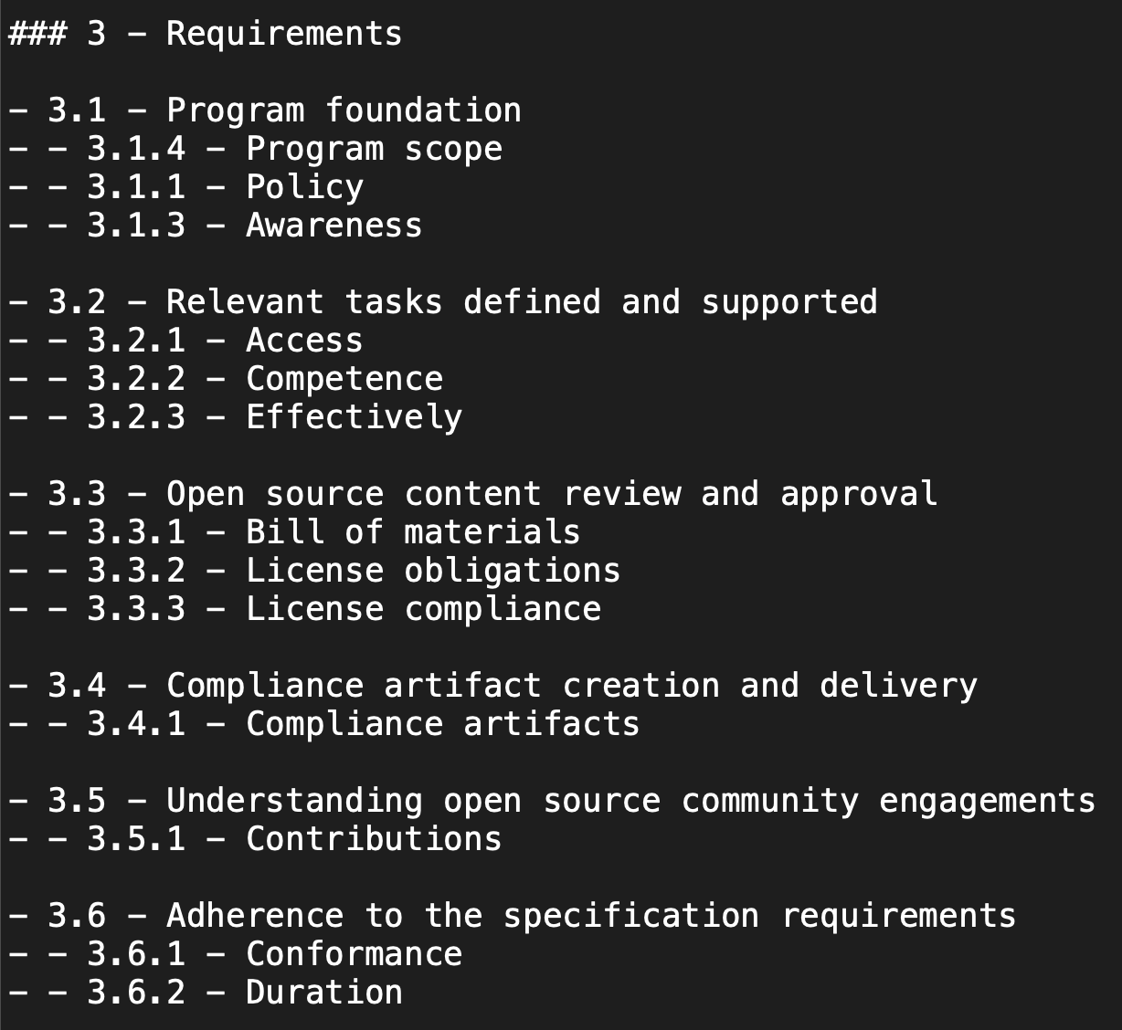
Example Suggestion for ISO/IEC 5230:2020

Slide 15
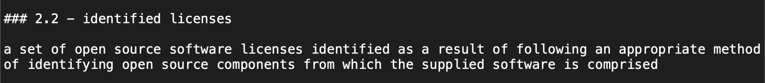
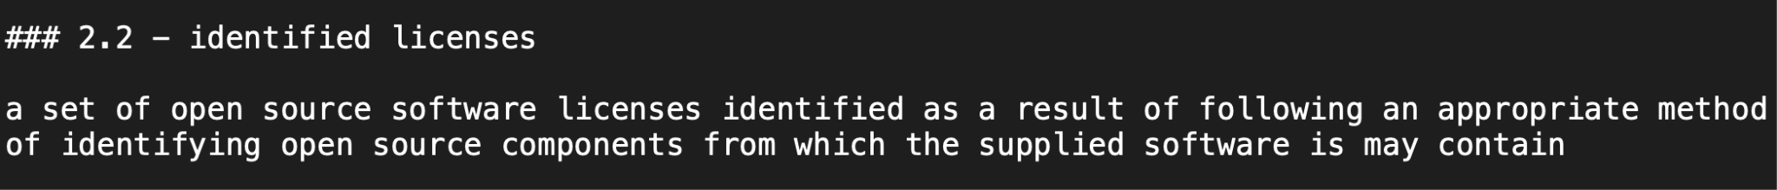
Example Suggestion for ISO/IEC 5230:2020
Example of the type of error the public comment period is for

Slide 16
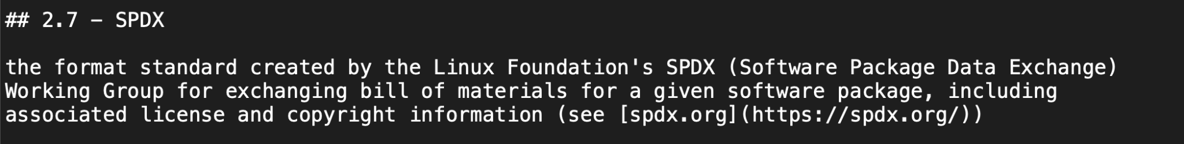
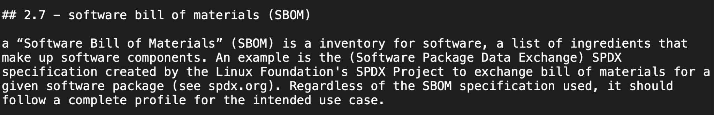
Example Suggestion for ISO/IEC 5230:2020

Slide 17
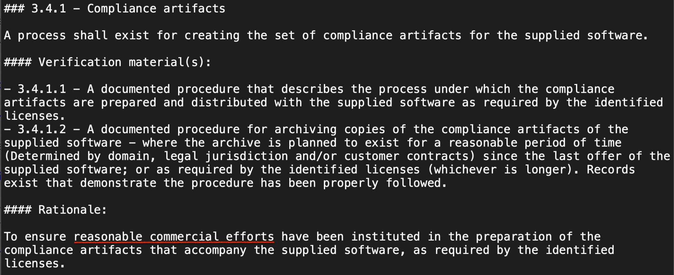
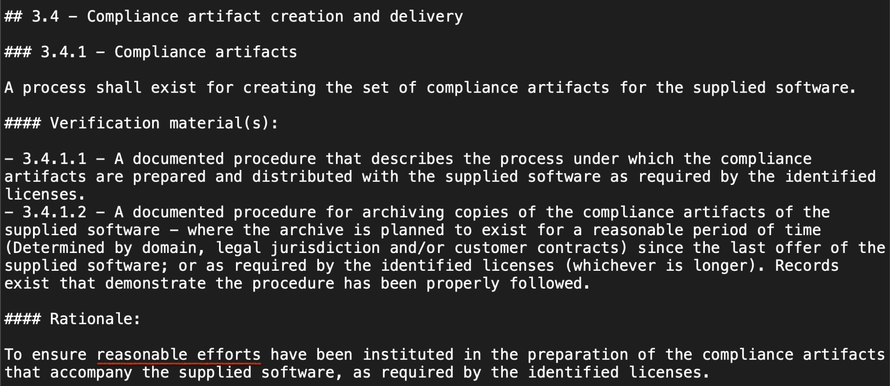
Example Suggestion for ISO/IEC 5230:2020

Slide 18
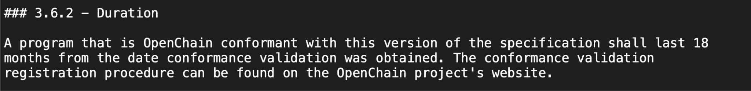
Example Suggestion for ISO/IEC 5230:2020

Slide 19
Review of suggested changes to ISO/IEC 18974:2023
Current ISO standard:
https://github.com/OpenChain-Project/Security-Assurance-Specification/blob/main/Security-Assurance-Specification/ISO-18974/en/ISO-18974.md
Current Next Generation Draft (pre-public comments period):
https://github.com/OpenChain-Project/Security-Assurance-Specification/blob/main/Security-Assurance-Specification/2.0/en/openchain-security-specification-2.0.md
All open issues have been closed by the Specification Work Group
https://github.com/OpenChain-Project/Security-Assurance-Specification/issues?q=is%3Aissue+is%3Aclosed
Next:
Six month public comment period launched 19th June 2024 as per our specification development process:
https://openchainproject.org/resources/faq#specification-development-questions
This will be followed by a Three Month freeze period

Slide 20
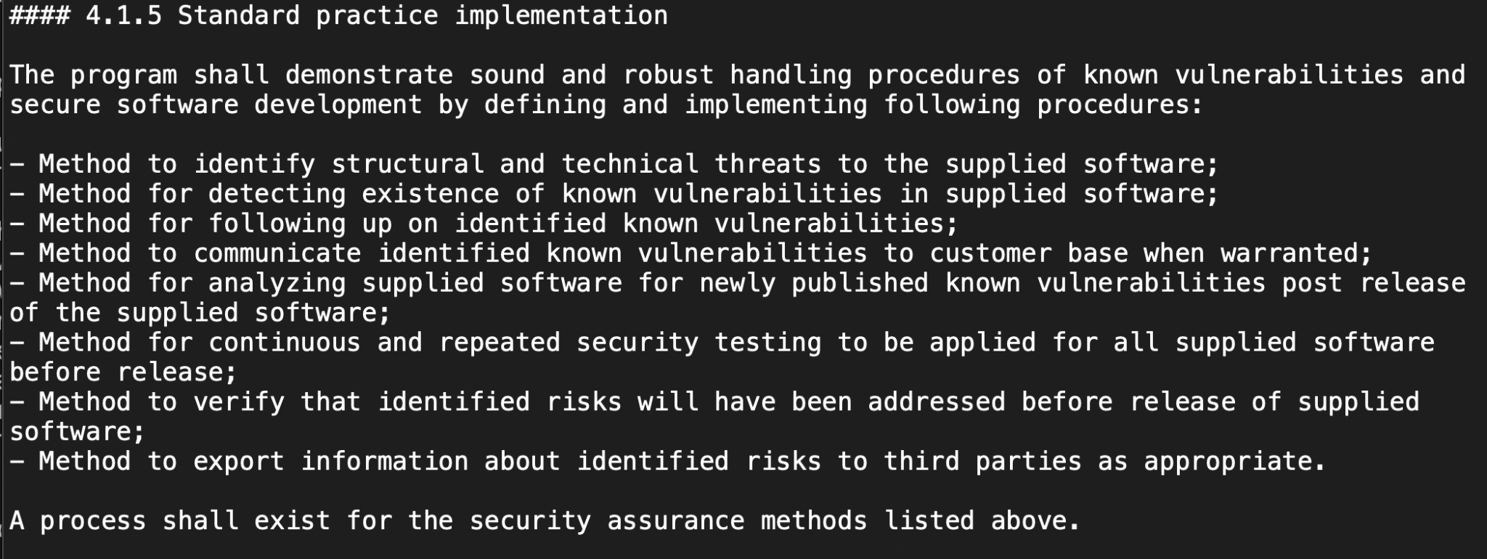
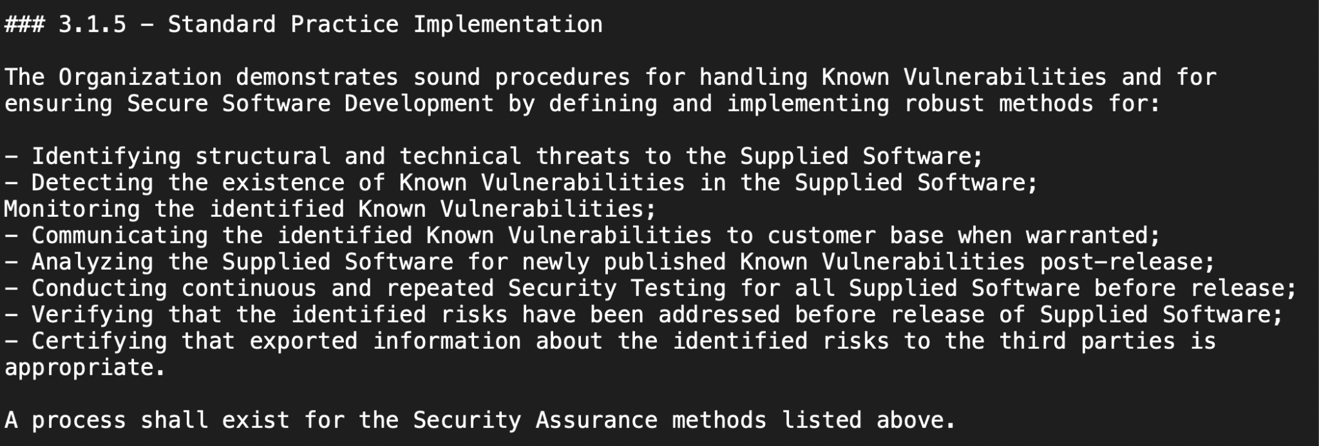
Example Suggestion for ISO/IEC 18974:2023

Slide 21
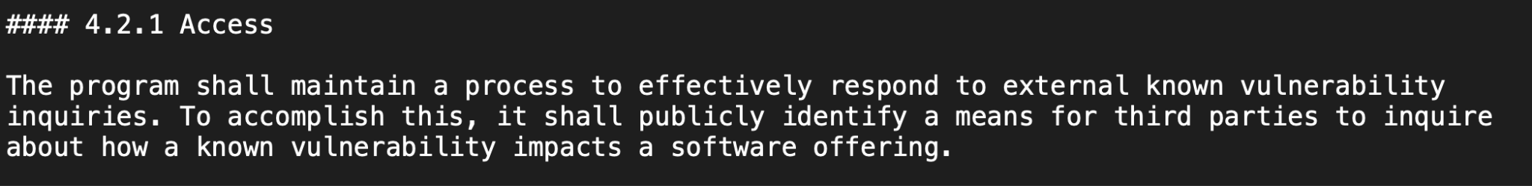
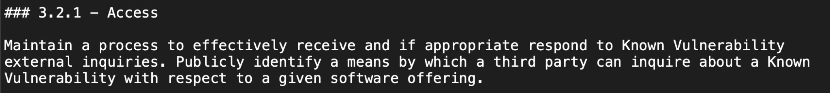
Example Suggestion for ISO/IEC 18974:2023

Slide 22
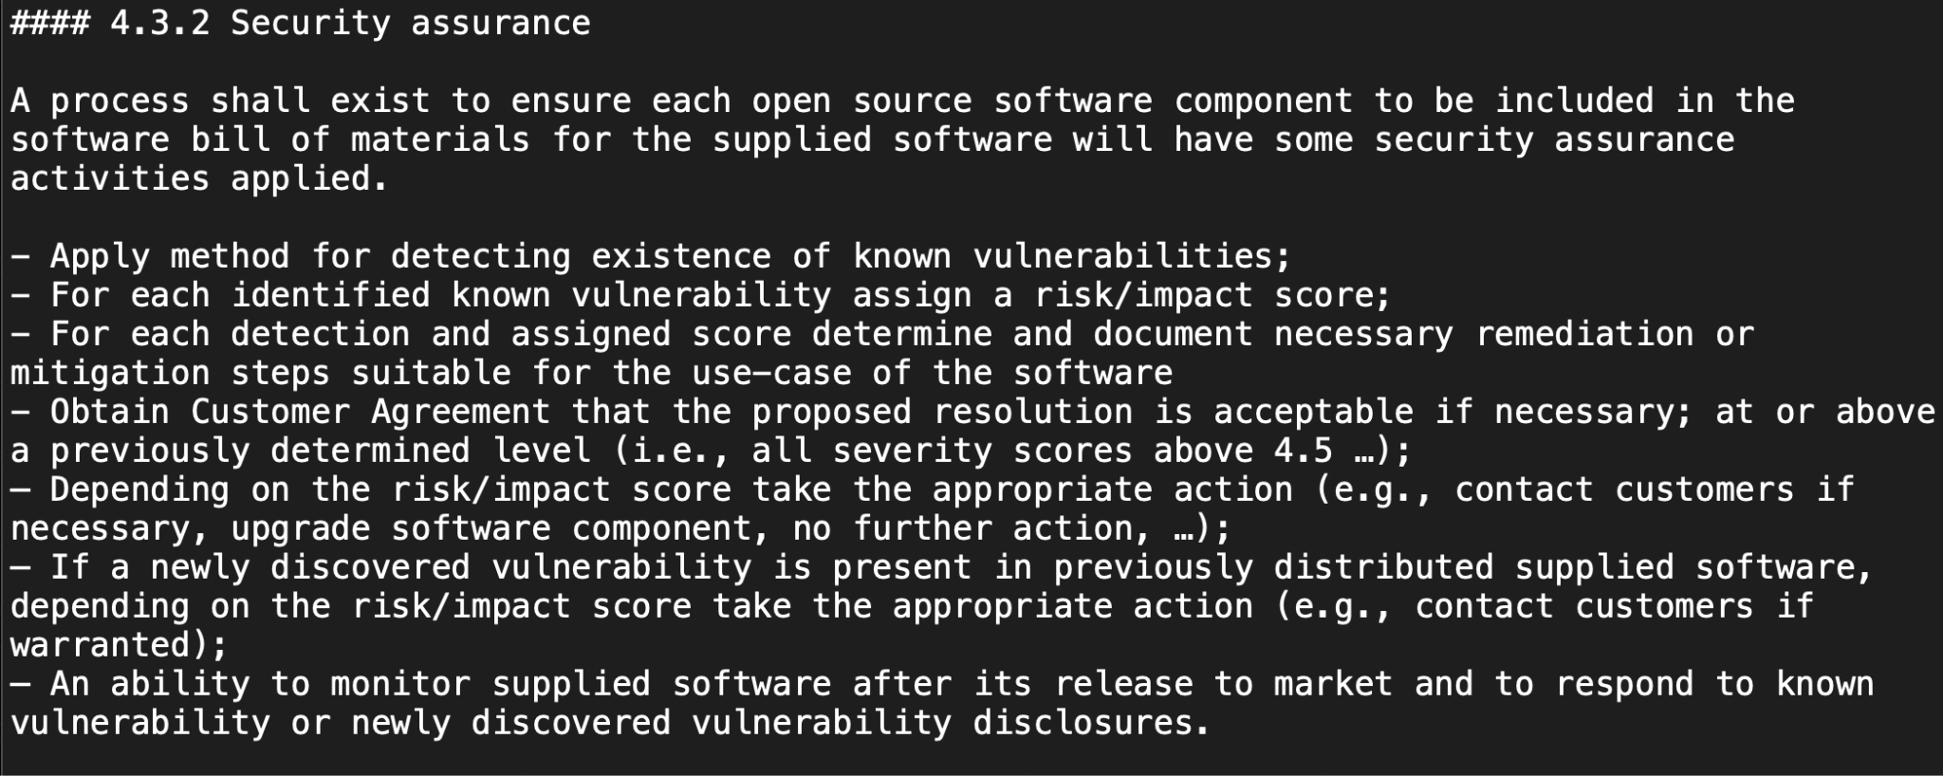
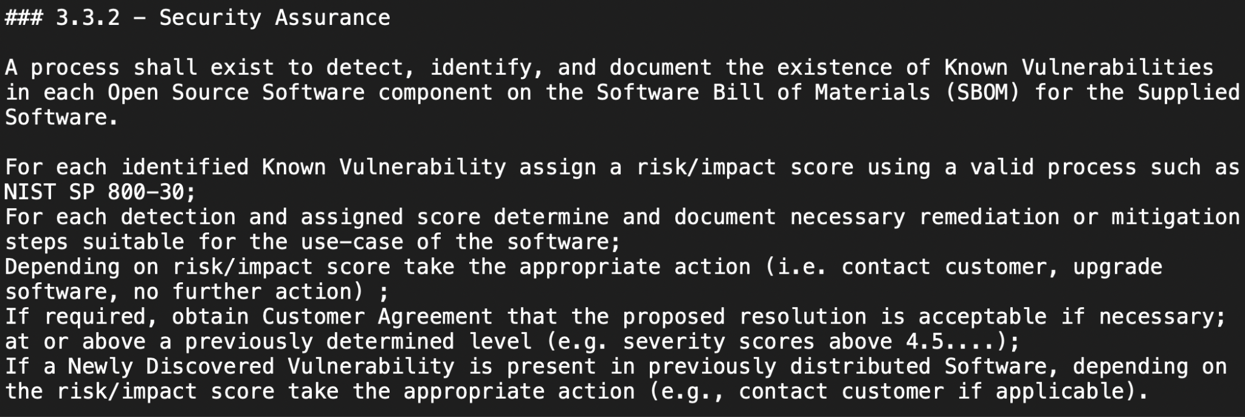
Example Suggestion for ISO/IEC 18974:2023

Slide 23
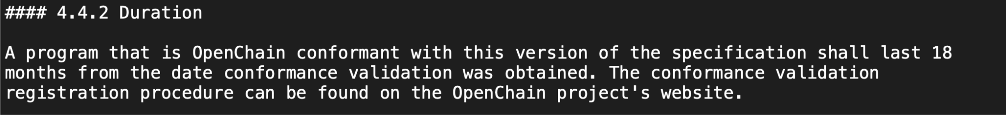
Example Suggestion for ISO/IEC 18974:2023

Slide 24
Questions?

Slide 25
Work on reference and supporting material

Slide 26
OpenChain Education Work Group – Monthly Meeting
We’ll be giving you an update on the progress we've making, and working on the following:
1. An overview of the new material released or coming soon
2. Collaborative work on new “explainers” for different company departments; and
3. Intro to an open maturity model and collaborative working on the bird’s eye view doc: https://docs.google.com/spreadsheets/d/1ubOwOeBLr6wN_l6JyzPYSRrf8Gn0sPitsb7j1gKJzP0/edit?usp=sharing
You can join at this link at 16:00 UTC on 2024-07-03: https://zoom-lfx.platform.linuxfoundation.org/meeting/96036013854?password=e0b01661-fb5f-419b-9de9-bed42c737cbc

Slide 27
Any other business

Slide 28
Close of meeting

Slide 29
See you next time!

